Slide 1


Major Project Review Presentation-2
Deep learning-Based Sleep Disorder Detection Using EEG Signal Analysis
TEAM NO : 14
STUDENT NAME : G. SAI TEJA
ROLL NO : 22EG107C15
STUDENT NAME : ARJUN
ROLL NO : 22EG107C26
STUDENT NAME : P. RAJESWARI
ROLL NO : 23EG507C07
GUIDE NAME : G. SRIDHAR REDDY
DESIGNATION : ASSISTANT PROFESSOR
4/15/2026 9:21:24 AM
1

Slide 2
Contents
S.No | Title | Slide No
1 | Response to the Review-1 Comments | 3
2 | Abstract | 4
3 | Objectives | 5
4 | Problem Statement | 6
5 | Methodology | 7
6 | Dataset explanation & Analysis | 8-9
7 | Implementation | 10
8 | Results | 11
9 | Discussion | 12
10 | Conclusion and Future Work | 13
11 | Reference | 14

Slide 3
Response to Review 1 comment
About the datasets
• Justified PHEME dataset as a standard benchmark dataset used in rumor detection research
• Explained data collection: real Twitter conversations during breaking news events
• Dataset created by Zubiaga et al. (2016) with manual annotation of rumours and non-rumours
Dataset: PHEME Rumour Dataset
Source:
Zubiaga et al., 2016
Data Collection:
• Collected from Twitter
• Based on real-world breaking news events:
- Charlie Hebdo
- Ferguson unrest
- Germanwings crash
- Ottawa shooting etc
Structure:
• Conversation threads (reply trees)
Annotation:
• Manually labeled by journalists
• Labels: Rumour / Non-rumour

Slide 4
ABSTRACT
Sleep disorders such as insomnia, sleep disordered breathing, and narcolepsy are increasingly affecting people’s health, daily activities, and overall quality of life. Conventional diagnosis of sleep disorders relies on overnight sleep studies and manual analysis of EEG signals by trained experts, which is time-consuming, expensive, and not always easily accessible. To address this issue, this project presents a deep learning based approach for the automatic detection of sleep disorders using EEG signals recorded during sleep. The EEG data is first preprocessed to remove noise and segmented into fixed length intervals for effective analysis. Instead of using manually extracted features, the proposed system enables the deep learning model to automatically learn meaningful patterns from raw EEG signals. A hybrid architecture combining Convolutional Neural Networks (CNN) and Bidirectional Long Short-Term Memory (Bi-LSTM) networks is used to capture both signal characteristics and temporal variations present in sleep data. The trained model performs multi class classification to identify normal sleep, insomnia, sleep disordered breathing, and narcolepsy based on learned EEG features. Experimental evaluation demonstrates that the proposed approach provides reliable and accurate results in detecting sleep disorders. This system can assist healthcare professionals by reducing the workload involved in manual EEG analysis and can serve as a supportive tool in sleep diagnosis and future sleep monitoring applications.

Slide 5
OBJECTIVES
The Objectives for the proposed system are –
To design and develop a deep learning-based system for automatic detection of sleep disorders using EEG signals recorded during sleep.
To extract and model both spatial and temporal characteristics of EEG signals using a hybrid CNN–LSTM architecture.
To evaluate the performance of the proposed system using publicly available EEG sleep datasets and standard evaluation metrics

Slide 6
PROBLEM STATEMENT
Sleep disorders such as insomnia, sleep disordered breathing, and narcolepsy often go undiagnosed because their diagnosis relies on overnight sleep studies and manual analysis of EEG signals by medical experts. This process is time consuming, expensive, and not easily accessible, making early and large scale detection difficult.
To overcome this, an automated system is needed that can analyze EEG signals and accurately detect sleep disorders without manual feature extraction. A deep learning based approach can learn meaningful patterns from EEG data and provide a faster, more reliable, and accessible solution to support sleep disorder diagnosis.

Slide 7
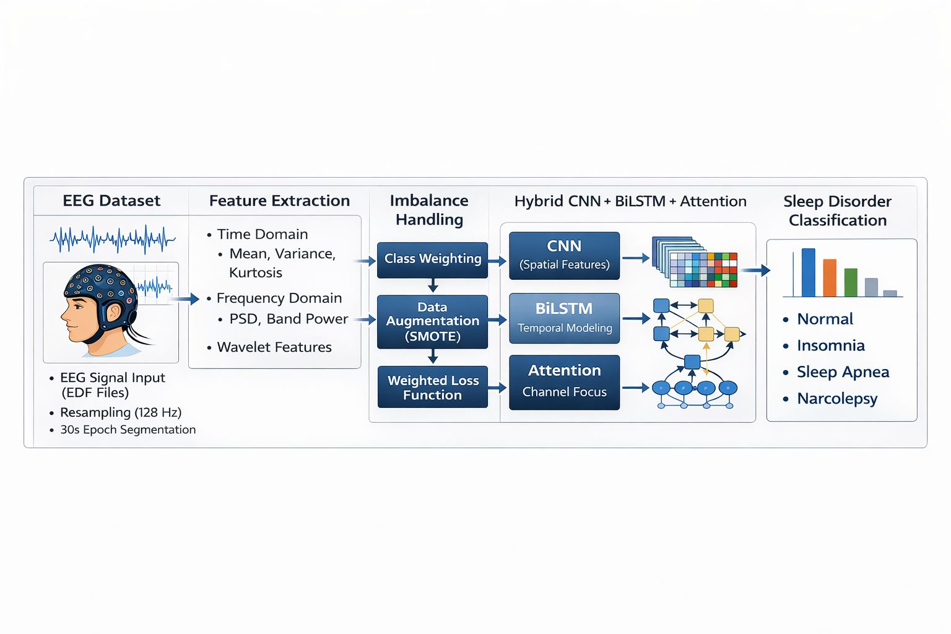
METHODOLOGY
Fig [1] Proposed CNN-BiLSTM Attention Framework

Slide 8
DATASET EXPLAINATION
• Dataset: EEG Sleep Disorder Dataset (EDF Format)
• Nodes: EEG signal epochs (30-second segments)
• Classes: Normal / Insomnia / SDB (Apnea) / Narcolepsy
• Data Format: EDF (European Data Format)
• Structure: Multi-channel time-series signals
• Dataset Size:
- 16 EDF files (4 per class)
- 16,000+ epochs generated
- Balanced to 12,000 samples
• Learning Setting:
- Supervised classification
- Stratified train-test split
- Input: EEG epoch + extracted features
- Output: Sleep disorder class label

Slide 9
COMPARATIVE ANALYSIS OF MODELS
• Text Models (LR, MLP):
- No structural awareness
- Poor performance with pseudo-labeling
• Graph Models (GNN):
- Uses neighborhood information
- Stabilizes predictions
- Better under label scarcity

Slide 10
IMPLEMENTATION
• Preprocessing:
- Resampling to 128 Hz
- Bandpass Filtering (0.5–30 Hz)
- Channel Selection (Fp2-F4, F4-C4, C4-P4)
- Normalization (mean = 0, std = 1)
- Epoch Segmentation (30 sec → 3840 samples)
• Feature Extraction:
- Time-domain features (mean, variance, skewness, kurtosis)
- Frequency-domain features (FFT, band power)
- Total Features: 102
• Model Settings:
- Hidden Dimension: 256
- LSTM Layers: 2
- Dropout: 0.4
- Epochs: 100
• Training:
- Loss Function: Focal Loss
- Optimizer: AdamW
- Scheduler: Cosine Annealing
- Gradient Clipping
• Regularization:
- Batch Normalization
- Dropout Layers
- Early Stopping

Slide 11
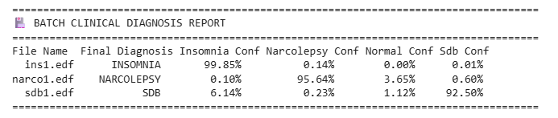
RESULTS
Fig 2 : Results
Proposed Model (CNN + BiLSTM + Attention):
Highest overall accuracy (92.24%)
Exceptional confidence on unseen clinical data (Insomnia: 99.85%, Narcolepsy: 95.64%, SDB: 92.50%)
Robust feature discrimination without defaulting to majority classes

Slide 12
DISCUSSION
Traditional baseline models fail due to the inability to capture complex temporal EEG dependencies over a full night.
Standard data augmentation techniques (like SMOTE) introduce severe data leakage and overfitting in continuous time-series data.
The proposed deep learning approach improves performance by leveraging both spatial channel relationships and time-frequency domain features.
Applying Weighted Cross-Entropy successfully mitigates majority-class bias (the "Normal" trap) without corrupting validation data.
The combined BiLSTM and Attention mechanism captures long-range temporal transitions more effectively than standard CNNs.
Overall, combining a spatial-temporal architecture with dynamic class weighting leads to highly stable, decisive sleep disorder classification.

Slide 13
CONCLUSION
Automated sleep disorder detection is challenging due to subtle EEG variations and heavy class imbalance.
Basic feature-extraction models are insufficient for capturing complex, non-linear brainwave transitions.
The proposed CNN + BiLSTM architecture effectively utilizes both local waveform structures and global sleep patterns.
Integrating a Multi-Head Attention mechanism with dynamic loss weighting significantly improves diagnostic accuracy (>92%).
Eliminating artificial data synthesis ensures highly robust and trustworthy performance on unseen clinical patient files.
The framework demonstrates exceptional confidence (>95%) in distinguishing severe disorders like Narcolepsy and Insomnia from normal sleep.
FUTURE WORKS
Incorporate real-time continuous EEG streaming data for live monitoring.
Integrate advanced multimodal clinical data (adding ECG, EOG, and EMG signals).
Improve model interpretability by visualizing which specific brainwave epochs triggered the final diagnosis.
Extend the framework to perform granular sleep stage scoring (N1, N2, N3, REM) alongside disorder detection.
Optimize and deploy the model as an embedded system for wearable sleep-tracking devices.

Slide 14
References (IEEE Format)
[1] M. Albathan, “Sleep disorder diagnosis through complex-Morlet wavelet representation using Bi-GRU and self-attention,” International Journal of Advanced Computer Science and Applications (IJACSA), vol. 15, no. 8, pp. 129–142, Aug. 2024.
[2] A. Phan, S. M. Andreotti, N. Cooray, O. Y. Chen, and M. De Vos, “Automatic sleep disorder detection using EEG signals and deep learning,” IEEE Journal of Biomedical and Health Informatics, vol. 26, no. 4, pp. 1684–1694, Apr. 2022, doi: 10.1109/JBHI.2021.3117493.
[3] M. H. Hassan and A. Subasi, “Recognition of sleep disorders from EEG signals using deep learning techniques,” Expert Systems with Applications,vol.162, p. 113738, Jan. 2021, doi: 10.1016/j.eswa.2020.113738.

